Slide 1
Creating lessons based on challenging mathematical tasks for yourself
Peter Sullivan

Slide 2
Abstract
While there are many wonderful resources available, the fastest way to create more challenging and engaging mathematics lessons is to do-it-yourself.
This session will outline 5 strategies for creating open-ended questions out of closed ones, challenging tasks out of mundane ones, and engaging lessons from text book questions.

Slide 3
Overview
Four strategies for creating open-middled and/or ended tasks
A fifth strategy based that uses text books
Creating some tasks
Creating some lessons (that use those tasks)

Slide 4
Either
Write down 2 standard text book type questions on a topic you have coming up
for a particular level

Slide 5
Strategy 1: Making things open by working from the answer
(this is the most powerful one)
Write down a question and work out the answer.
Make up a new question that includes the answer as part of the question.

Slide 6
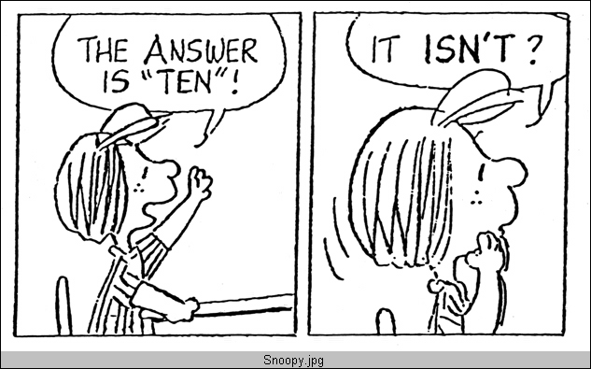

Slide 7
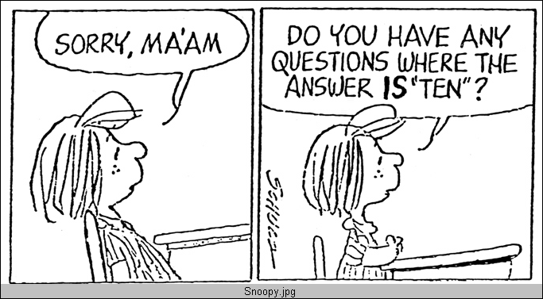

Slide 8
What is there 4 of?
What is there in this room that there is exactly 4 of?

Slide 9
Rounding
A number has been rounded off to 8.7. What might be that number?

Slide 10
Fishing
Seven people went fishing.
The mean number of fish the people caught was 5, the median was 4, and the mode was 3.
How many fish might each person have caught?

Slide 11
6 right angles
Draw a closed shape that has 6 internal right angles
If the perimeter of your shape is 1 km, what might be the dimensions of the sides?

Slide 12
SA = 22
The surface area of a rectangular prism is 22 sq cm.
What might be the dimensions?

Slide 13
Half way between
7.1 is halfway between two numbers. What might be the numbers?

Slide 14
What is the similar about each of those examples?

Slide 15
Apply that strategy to the questions you identified earlier

Slide 16
Strategy 2: Making tasks open by removing parts
Write down a complete question including the answer.
Remove some of the question parts.

Slide 17
LEARNING TASK
I did an addition question correctly for homework, but my printer ran out of ink.
I remember it looked like
__ 4 + __ = __ 0
What might be the digits that did not print?
(Give as many sets of answers as you can).

Slide 18
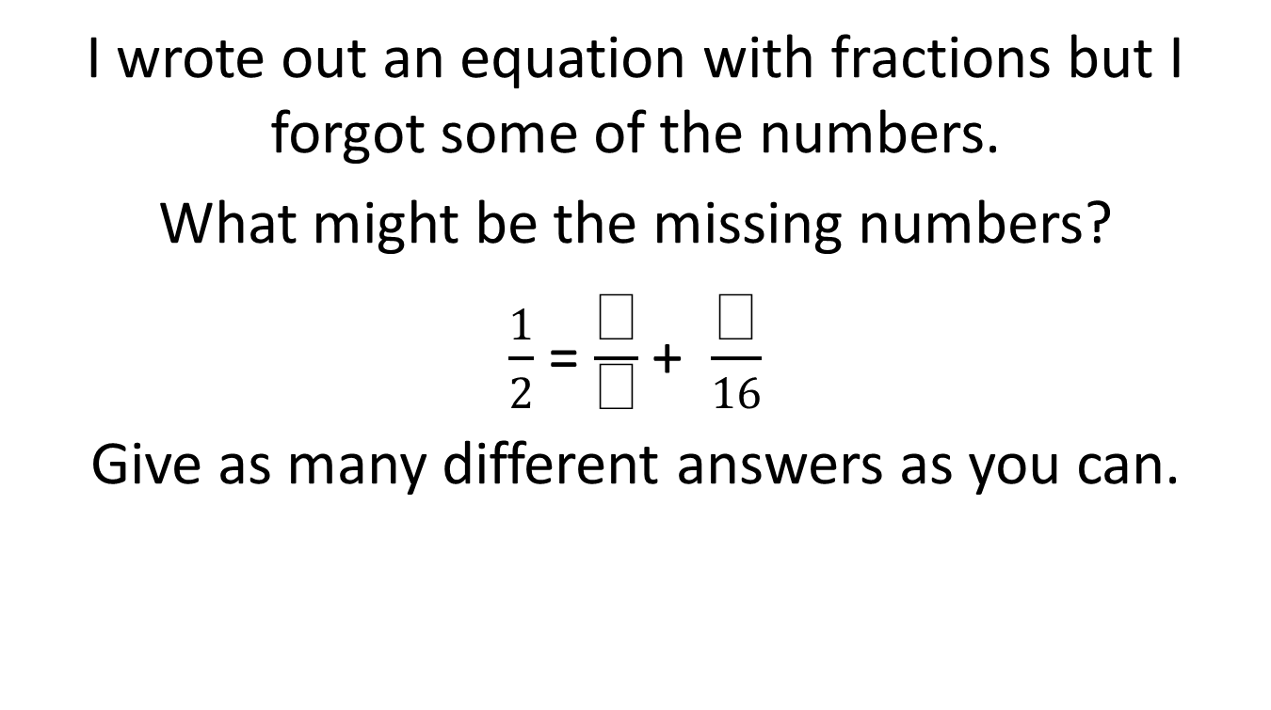
LEARNING TASK

Slide 19
I did a multiplication question correctly for homework, but my printer was out of ink. I remember it looked like
2 . __ × 3 . __ = __ . __
What might be the digits that that did not print?
(give as many answers as you can)

Slide 20

LEARNING TASK
Place each of these numbers onto one of the empty squares to make the sentence true. Find as many different ways of doing this as you can.
>
Record your solutions

Slide 21
Inequalities
Where might you place these cards on this inequation?
__ .__ __ < 3. __
(How many different answers are there?)
3
0
2
6

Slide 22
What might be the missing terms?
  4x + 3 = __ + __ + __

Slide 23
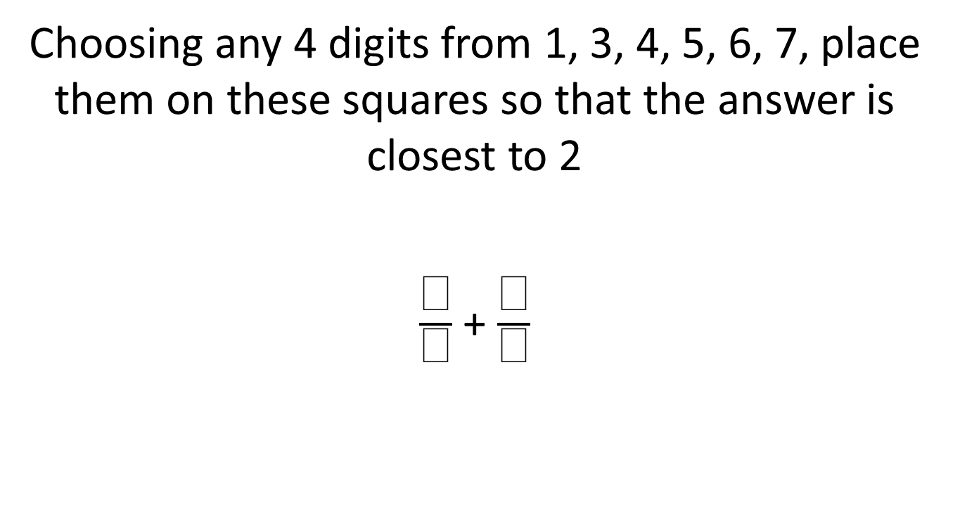
CLOSEST TO 2

Slide 24
What is the similar about each of those examples?

Slide 25
Apply that strategy to the questions you identified earlier

Slide 26
Strategy 3: Openness through personalising
This can be either about them
Or they create their unique solution
It makes it obvious to the students that they have to engage their own minds in solving the task.

Slide 27
Write your name using 50 matchsticks

Slide 28
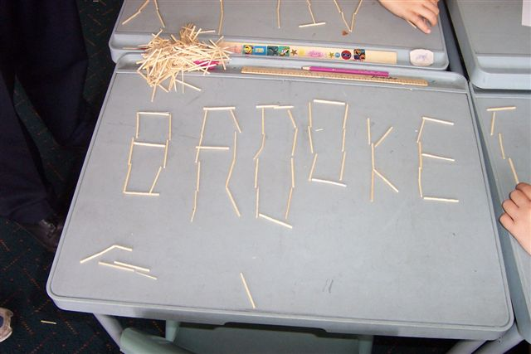

Slide 29
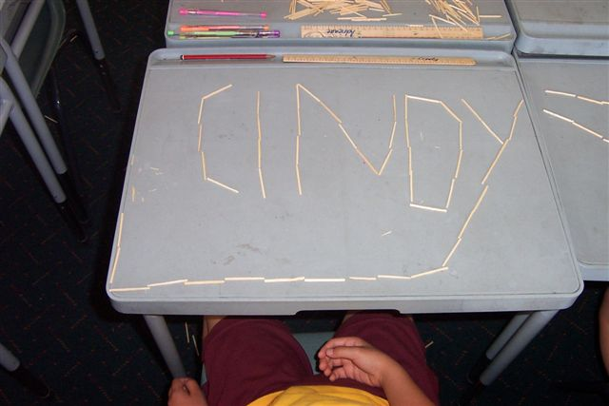

Slide 30
Some further examples
Write a sentence with 5 words with the mean number of letters per word being 4
Draw a graph to show how hungry you are over the day?
Someone has a BMI of 27. What might be their height and weight? How does this compare with you?

Slide 31
Apply that strategy to the questions you identified earlier

Slide 32

Shoes
Rose and Ann go shopping for shoes. Rose chooses one pair for $110 and another for $100. Ann chooses a pair that cost $160.
When they go to pay, the assistant says that there is a sale on, and they get 3 pairs of shoes for the price of 2 pairs.
Give two options for how much Rose and Ann should each pay?
Explain which option is fairer.
Special offer
THREE PAIRS FOR THE PRICE OF TWO
The free pair is the cheapest one
Special offer
THREE PAIRS FOR THE PRICE OF TWO
The free pair is the cheapest one

Slide 33
Strategy 4: “Forcing” connections
One approach is to address two or more concepts and build connections between them
Another approach is to represent solution methods in two ways

Slide 34
Addressing concepts “simultaneously”

Slide 35
Multiplication and division
Some people came for a sports day.
When the people were put into groups of 3 there was 1 person left over.
When they were lined up in rows of 4 there were two people left over.
How many people might have come to the sports day?

Slide 36
?

Slide 37
CARTESIAN SQUARES
Four lines meet in such a way as to create a square. One of the points of intersection is
(-3, 2)
What might be the co-ordinates of the other points of intersection?
What might be the equations of the lines?
Give two different answers. One of the squares should not have any horizontal lines.

Slide 38
What is the similar in each of those examples?

Slide 39
Apply that strategy to the questions you identified earlier

Slide 40
Representing solutions in two ways, …

Slide 41
Pretend that you are using a calculator that has the “4” button broken.
How could you work out the answer to …
341 + 274
Method 1 | Method 2

Slide 42
If this is 3
Draw what might be 1
Represent your solution using two DIFFERENT methods.

Slide 43
Another example, …
A pen and a pencil together cost $7.
The pen costs $6 more than the pencil.
How much does the pencil cost?
Represent your solution using two DIFFERENT methods.

Slide 44
What is the similar in each of those examples?

Slide 45
Apply that strategy to the questions you identified earlier

Slide 46
A fifth approach: Using the text book in different ways

Slide 47
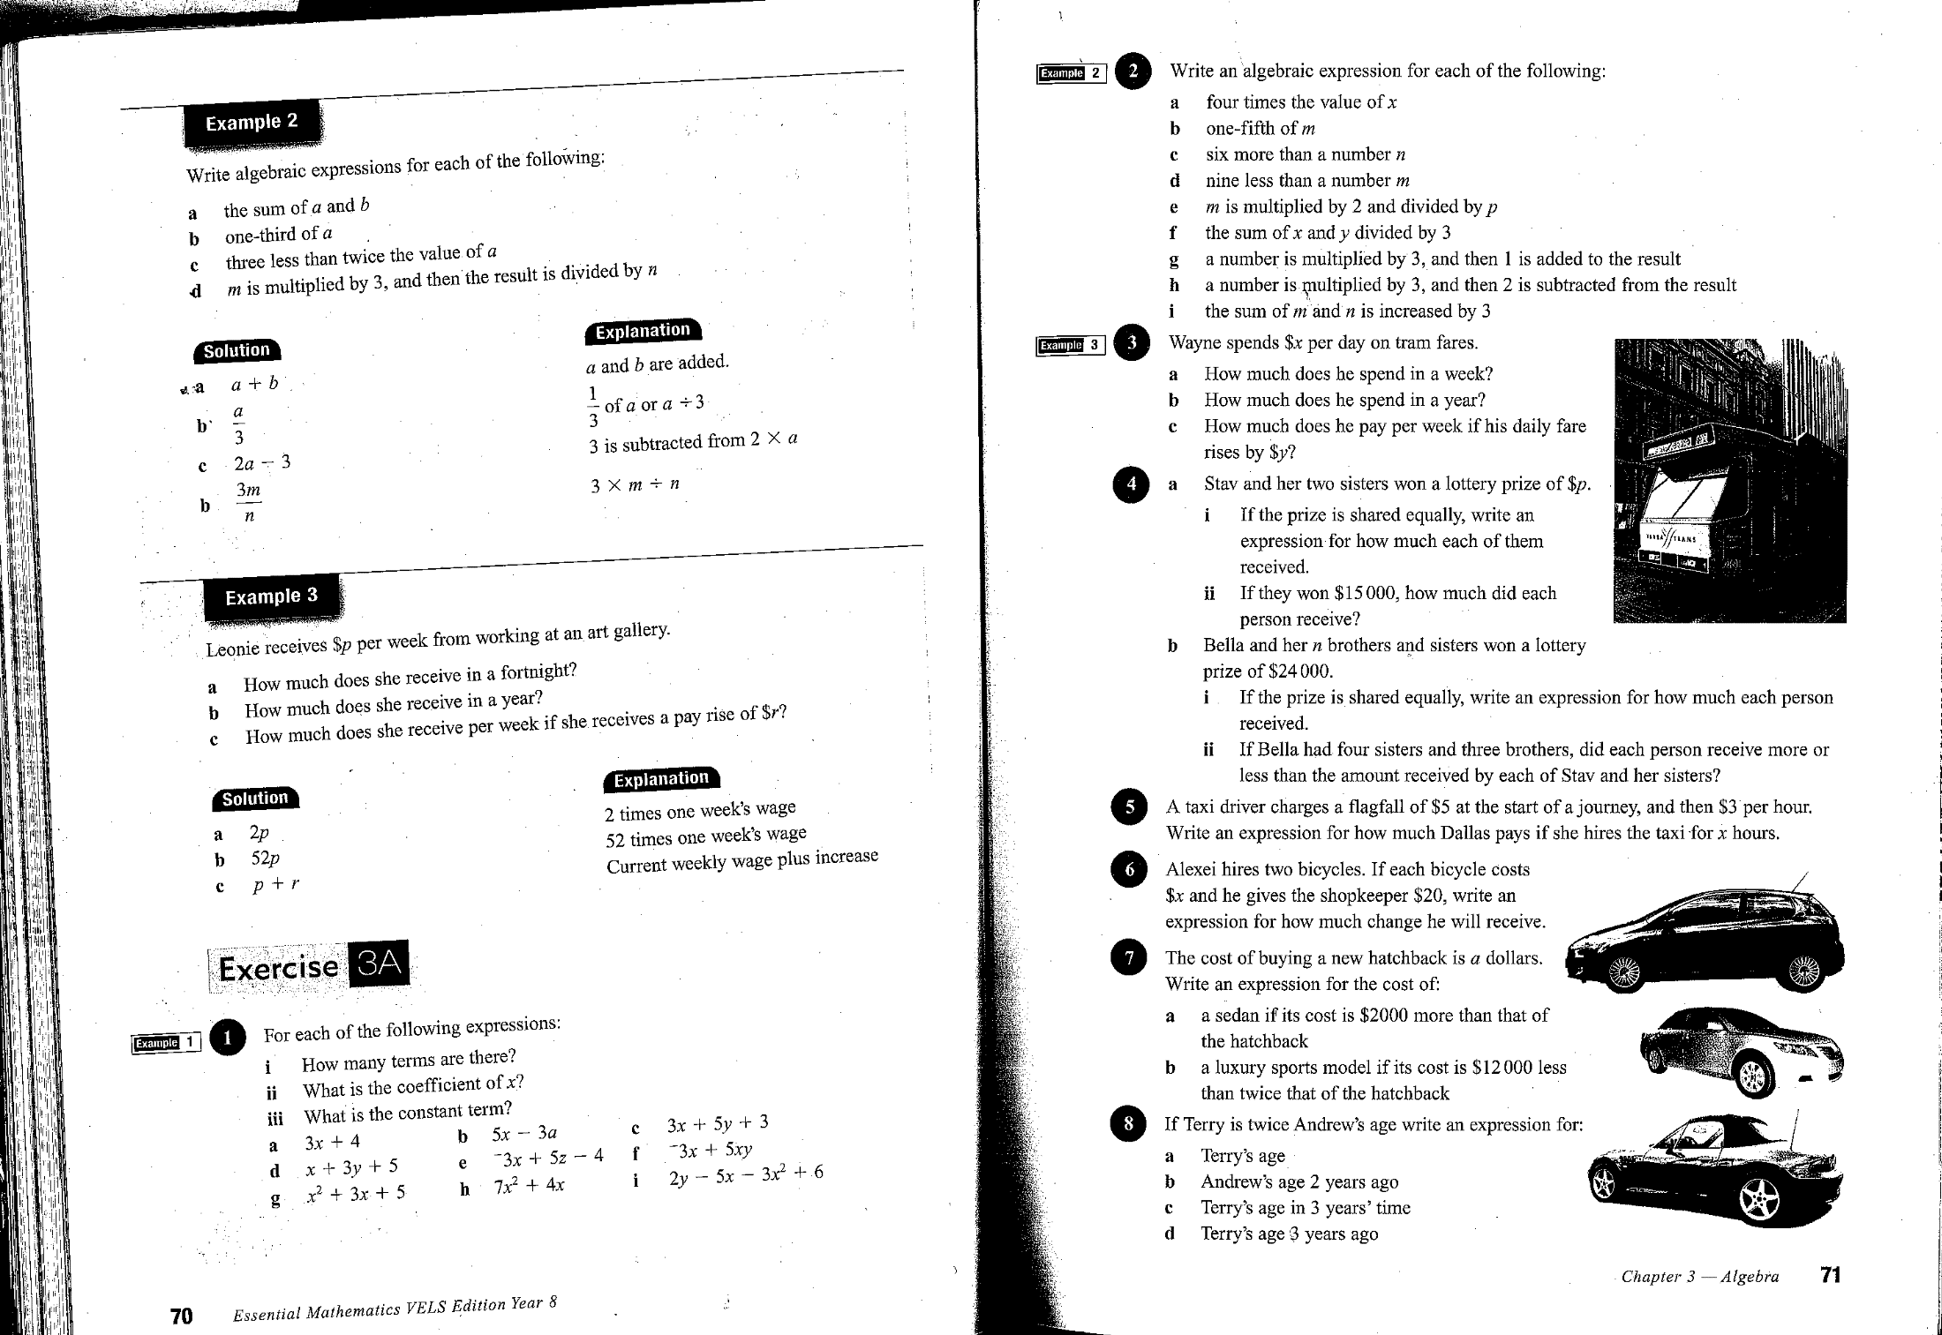
Consider this example
(an example of a text page)

Slide 48
Some examples
In what ways are the questions in this exercise similar?
In what ways are the questions different from each other?
Which questions match the example at the start and which do not?
In what ways is question 2 harder than question 1?
In what ways is question 10 harder than question 1?
In what ways does question 1 help you answer question 2?

Slide 49
Some more examples
Which questions can you do in your head?
Which is the first question you cannot do? Start working at the question before that one.
Read the last question first. What do you need to learn to be able to do that questions? Which of the earlier questions look like they might help?
Work in pairs. One of you does the odd questions. The other does the even ones. Then each of you can explain your working to the other.

Slide 50
The lessons consist of
One or more challenging task(s)
preliminary experiences that are pre-requisite but which do not detract from the challenge of the tasks
supplementary tasks that offer the potential for differentiating the experience through the use of
  enabling prompts (see Sullivan, et al., 2009) which can reduce the number of steps, simplify the complexity of the numbers, and vary the forms of representation for those students who cannot proceed with the task;
  extending prompts for students who complete the original task quickly which often prompt abstraction and generalisation of the solutions.
One or more consolidating task(s)

Slide 51
Now choose one task and create a lesson for your tasks

